Slide 1
Centre of Excellence
&
Quality
Prof. Dr. M.Hakan KESKİN
Vice Rector
Head of Excellence Center
mhakankeskin@aydin.edu.tr
Istanbul Aydın University, January 2023

Slide 2
the standard of something as measured against other things of a similar kind; the degree of excellence of something.
quality

Slide 3
excellence
a measure of consistently superior performance that surpasses requirements and expectations without demonstrating significant flaws or waste.

Slide 4
Excellence Centers

Slide 5
Quality
Istanbul Aydın University
Agile Transformation Process

Slide 6
Istanbul Aydın University
Agile Transformation Process
Common Sense
Psychological and technical barriers
Belief Stability Support
Joint Action
We have dreams that are said to be impossible...

Slide 7
IAU Agile Transformation Process
Agile Transformation
Action plan
100 Action
2021
August
Akıl Teri
Action Plan
28 Action
2022
January
2023
January
Academic Motion
Action Plan
? Action
İAÜ Agile Transformation Process
Common Sense
We have dreams that are said to be impossible...
Joint Action

Slide 8
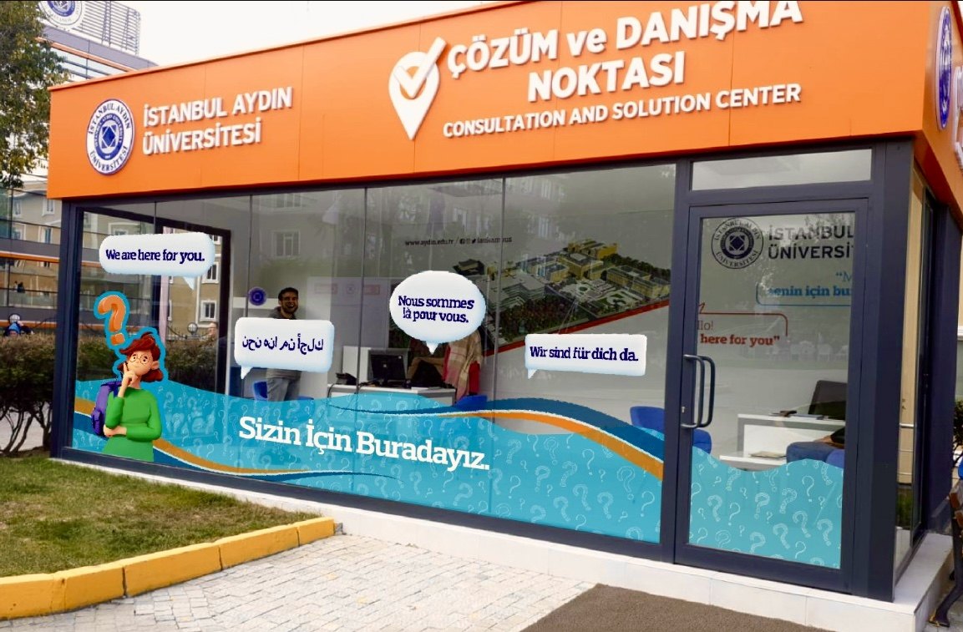
Feedback System
Website of University
Solution Center
Surveys
Conferences
Focus groups

Slide 9
the Search Conference
6 themes
Quality of Education
Academic Qualification
Human Resources
Student Centered University
Management Blindness
Promoting an International University

Slide 10
Action Plan
Strategic Plan
actions
goals
Agile Transformation Process

Slide 11
Centre of Excellence
&
Quality
Prof. Dr. M.Hakan KESKİN
Vice Rector
Head of Excellence Center
mhakankeskin@aydin.edu.tr
Istanbul Aydın University, January 2023

